Slide 1
City of Chicago
Crimes - 2018

Slide 2
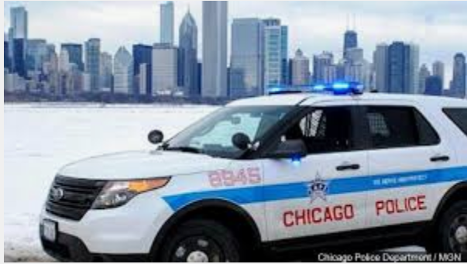
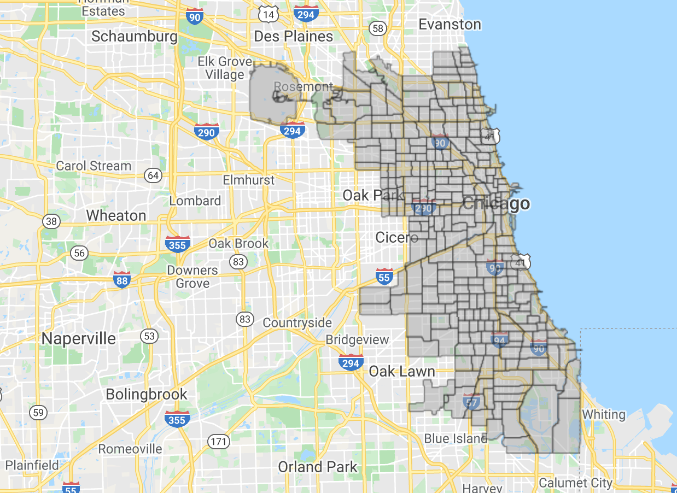
Chicago Crime Analysis summary of Data used
Arrest – Yes/No
Date/Time of crime
Type of Crime - IUCR - Illinois Uniform Crime Reporting code https://data.cityofchicago.org/Public-Safety/Chicago-Police-Department-Illinois-Uniform-Crime-R/c7ck-438e/data, with primary type of crime
Domestic Violence – Yes/No
Location of crime by City Council district, community area, block, and description
FBI Code - Code of crime by FBI Code
http://gis.chicagopolice.org/clearmap_crime_sums/crime_types.html
Source: wifr.com
Current police beat boundaries in Chicago.
Source: https://data.cityofchicago.org/Public-Safety/Boundaries-Police-Beats-current-/aerh-rz74

Slide 3
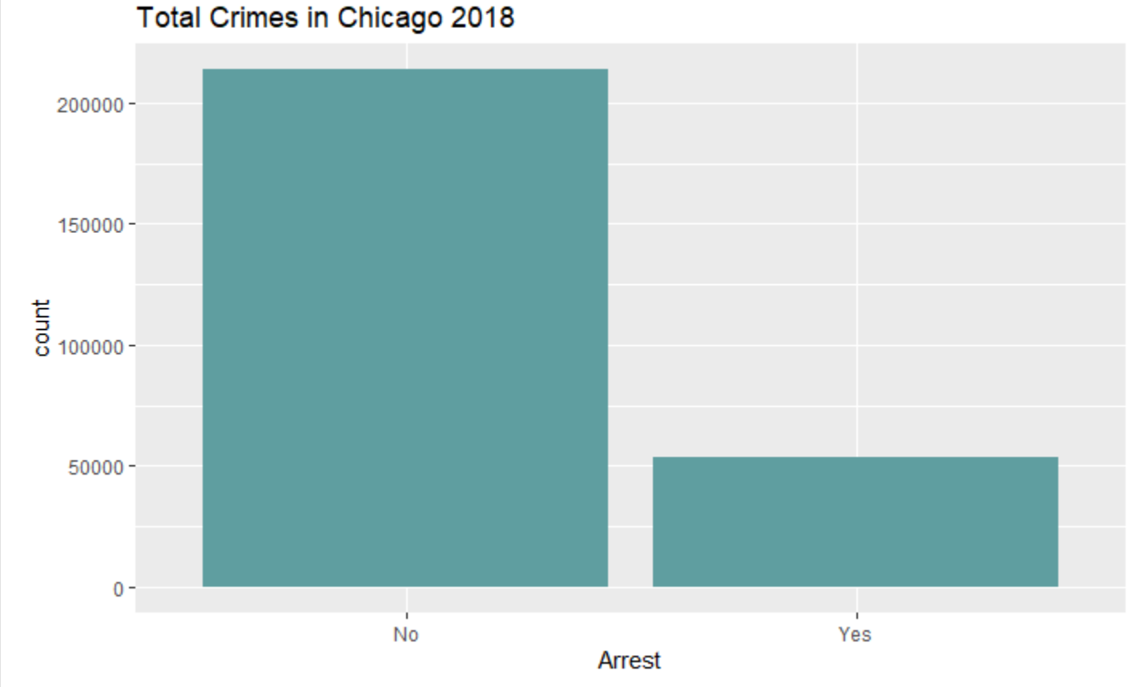
267,185 Crimes Total 53,416 Arrests

Slide 4
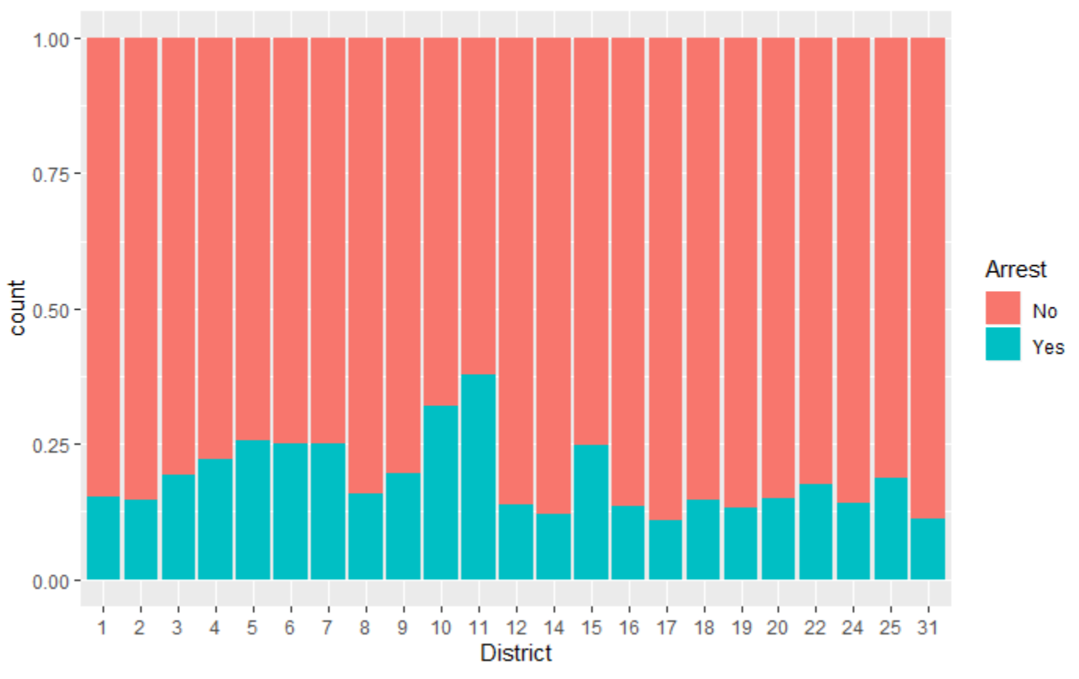
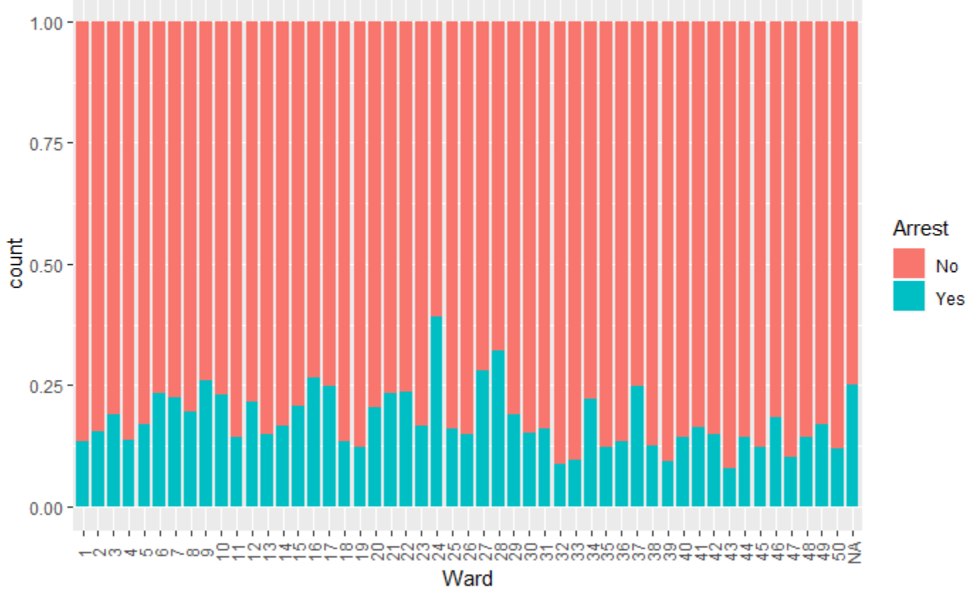
Crimes by District and Ward
District
ward
Most arrest have been made in Districts 10, 12, & 15
Least arrest in Districts 14, 17, & 31
Most arrest have been made in Wards 24, 28, & 27
Least arrest in Districts 32, 33, & 43
There is correlation in these districts/wards to Arrests

Slide 5
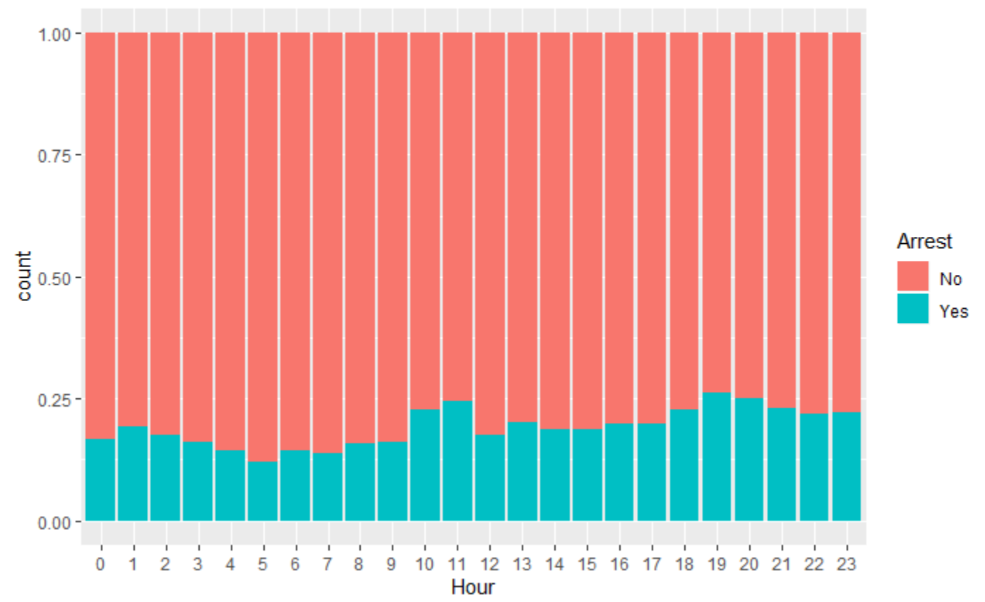
Arrests by Hour Arrest increase in the 10th & 11th Hour, then again in the 18th, 19th, 20th hour
Potential correlation in hours of the day to Arrests, specifically in the later hours of the day

Slide 6
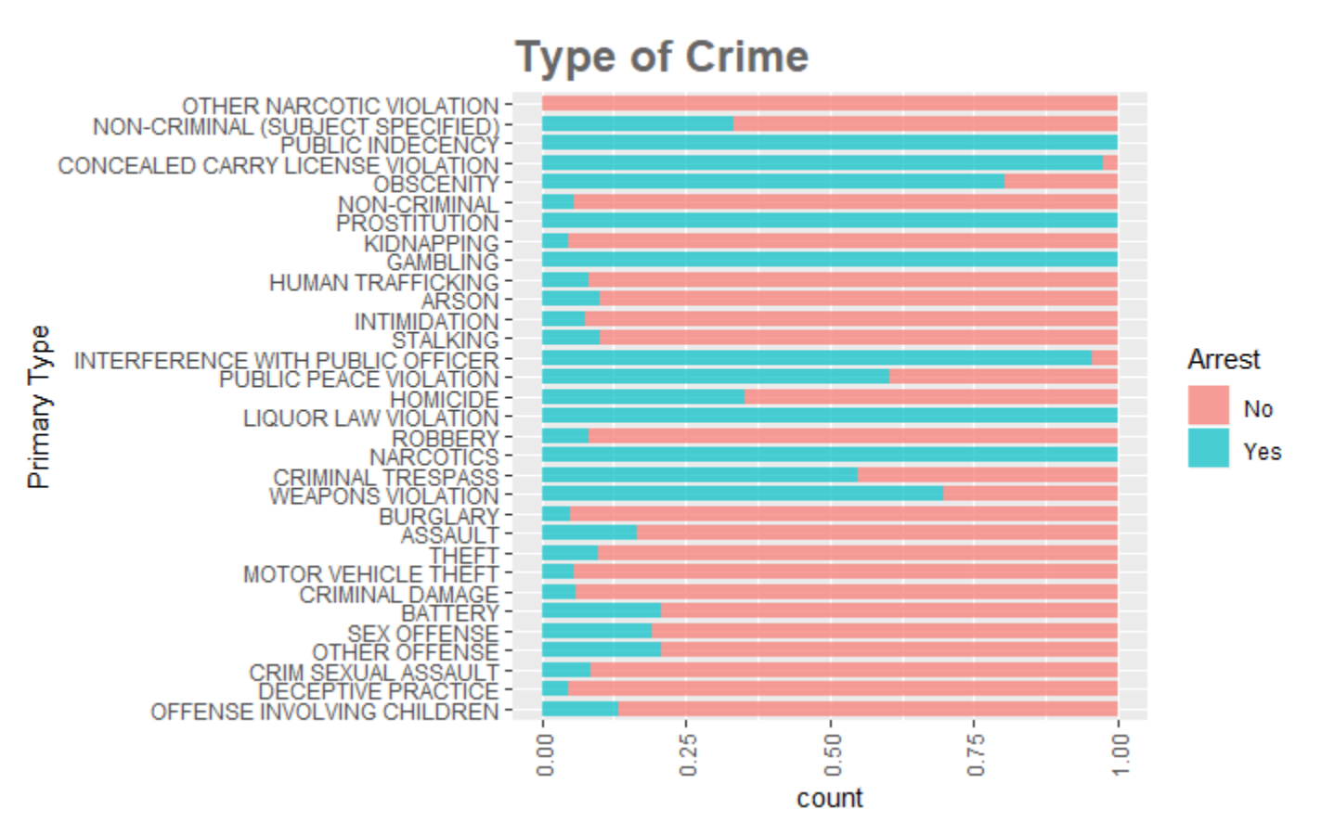
Type of Crime
There is definite correlation in arrest, based on the type of crime. Crimes, such as, Public Indecency, Prostitution, Gambling, Liquor Law Violation, & Narcotics are either 100% or nearly 100% arrests.

